Slide 1

Shadow words: Connecting grammar and vocabulary
Alice Savage & Colin Ward
Lone Star College – North Harris

Slide 2
High frequency words

Slide 3
Words
Content | Grammar | Shadow
fork store smell traffic | for the be since | place important bring achieve
Vocabulary selected from Trio Writing
Oxford University Press (in press)

Slide 4
The dynamic nature of words
“Words are not isolated units of language, but fit into many interlocking systems.”
- Paul Nation

Slide 5
Which category is each word?
 | Content | Grammar | Shadow
1. approach |  |  | ✔
2. hill | ✔
3. however |  | ✔
4. atmosphere |  |  | ✔
5. natural |  |  | ✔
6. sky | ✔
7. realize |  |  | ✔
8. towards |  | ✔

Slide 6
Ways to practice

Slide 7
Vocabulary strategies
Sensory Cues – Joshua Foer
Multiple hits – Paul Nation
Brief encounters – Keith Folse
i + one – Stephen Krashen
Clusters and chunks – Norbert Schmidt/Eli Hinkle
Reiteration – Diane Larsen-Freeman

Slide 8
Practice Activity 1: Strange Dictation
Student
Put your pen/pencil in your left hand (or right hand if you are left handed)
Write the words you hear.
Repeat
Use your regular hand, but write the words backwards.
Teacher
Say the target words once.
Say it in a sentence.
Repeat the words.

Slide 9
Practice Activity 2: Taboo
Partner A:
Face the screen.
Look at the phrases and pictures.
Say anything you can to help your partner guess the phrase, but do not say it.
Partner B:
Face your partner with your back to the screen.
Listen to your partner, and guess the phrase.

Slide 10
Practice Activity 3: Mix & Match
Adjectives | Nouns
popular | stadiums
dangerous | gamers
local | sports
talented | athletes
professional | competitions
Students:
Get in pairs.
Match words and make phrases.
Make, ask and answer questions.
Where?
What?
Why?

Slide 11
Practice Activity 4: Word Forms
Partner A:
Look at phrase A.
Create a sentence that describes the picture.
Partner B:
Look at phrase B.
Create a sentence that describes the picture.

Slide 12
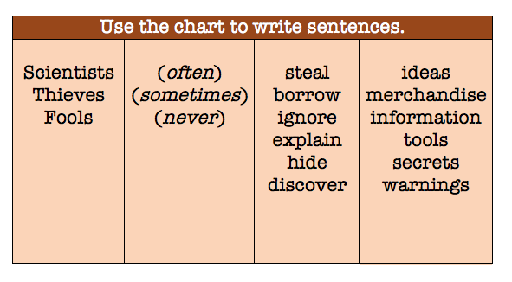
Practice activity 5: Flow Charts
Questions
What is your favorite sentence?
What does the sentence mean?
What are some examples?
Students:
Write two sentences.
Share your sentences.
Discuss the meaning.

Slide 13
Practice activity 6: Assists
Add nouns or noun phrases to write simple introductory sentences.
1. My son pointed at…
2. He was amazed by the…
3. In the distance, there were…
4. We looked up and noticed a…
5. He had never experienced…

Slide 14
Practice Activity 7: online 3-2-1
Students:
Use your device. Go to www.just-the-word.com
Look up the target words. Write:
    3 phrases.
    2 sentences.
    1 question.
Share your phrases and sentences. Ask your partner the question. Answer your partner’s question.
Student A
ordinary
Student B
join

Slide 15

Other activity types
Pictionary
Hangman
Charades
Concentration
Word chains
Round robin
With a phone?

Slide 16
Contact Info & Website
Visit our website and blog!
englishendeavors.org
Contact us:
alice.o.savage@lonestar.edu
colin.s.ward@lonestar.edu

Slide 17
References
Clay, B., Blythe, R., Bybee, J., Christiansen, M., Croft, W., Ellis, N., Holland, J., Ke, J., Larson-Freeman, D., Shoenemann, T. (2009). Language is a complex adaptive System: Position Paper. Language Learning 59 (pp. 1-26). Michigan: University of Michigan.
Ellis, R. (1997). Vocabulary acquisition: word structure, collocation, word-class, and
meaning. In N. Schmitt & M. McCarthy (Eds.), Vocabulary: Description, acquisition, and pedagogy (pp. 122-139). Cambridge: Cambridge University Press.
Foer, J (2011). Moonwalking with Einstein: The Art and Science of Remembering Everything. New York, NY: The Penguin Press
Granger, S. (1998). Prefabricated patterns in advanced EFL writing: collocations and lexical phrases. In A. Cowie (Ed.), Phraseology: theory, analysis and applications (pp. 145-160). Oxford: Oxford University Press.
Hinkel, E. (2012). Innovative and Efficient Construction Grammar. Selected papers
from the 21st International Symposium on English Teaching. English Teacher’s Association, Republic of China (ETA-ROC), Taipei, 51-59.
Hinkel, E. (2011) What research on second language writing tells us and what it doesn’t. In E. Hinkel (Ed.), Handbook of research in Second Language Teaching and Learning, Volume 2 (pp. 523-538). New York: Routledge.

Slide 18
References
Hinkel, E. (2004) Teaching academic ESL writing: Practical techniques in vocabulary and grammar. Mahwah, NJ: Lawrence Erlbaum.
Krashen, S. (1981). Second Language Acquisition and Second Language Learning Theory. London: Pergamon Press Inc
Larsen-Freeman, D. (1997). Chaos/complexity science and second language acquisition. Applied Linguistics, 18, 141-165.
Nation, I.S.P. (2001). Learning vocabulary in another language. Cambridge: Cambridge University Press.
Schmitt, N. (2000). Lexical chunks. ELT Journal, Volume 54 (4). Oxford: Oxford University Press.

