Slide 1

Breaking the Mold: Paragraphing for Beginners
Colin S. Ward
Lone Star College – North

Slide 2
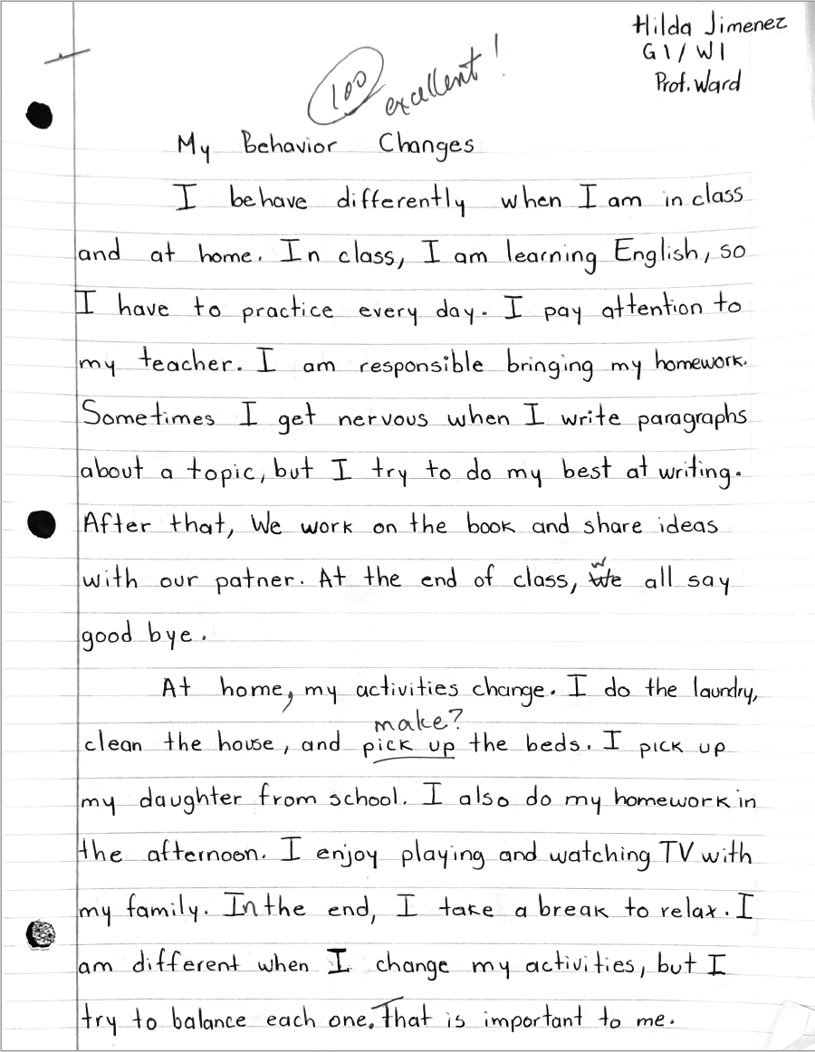
What is this student’s level?
Notes:
Read
Where would this student be placed in your program?

Slide 3
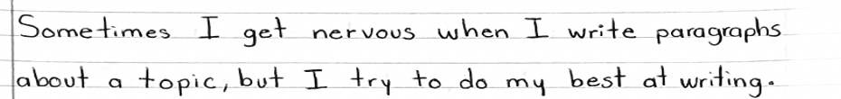
A compound-complex sentence?!
Do we have to delay it?
Do we need to point it out?
Notes:
One of my weakest students

Slide 4
What are beginning writers capable of?
Words?
Phrases?
Sentences?
Paragraphs?

Slide 5

What is CEFR?
Notes:
A lot of people, esp. publishers, look to CEFR levels

Slide 6
Basic User | A1 | Beginner
 | A2 | Elementary
Independent User | B1 | Intermediate
 | B2 | Upper Intermediate
Proficient User | C1 | Advanced
 | C2 | Proficiency

Slide 7
CEFR A1
Simple sentences
Can produce simple phrases and sentences about themselves and imaginary people, where they live and what they do.
Can describe in very simple language what a room looks like.
Can use simple words and phrases to describe everyday objects.
Notes:
Not English Specific
Descriptors
Beginner

Slide 8
CEFR A2
Can produce a series of simple phrases and sentences about their family, living conditions, educational background, or present or most recent job.
Can use sentences with simple connectives like “and,” “but” and “because”.
A smattering of compound sentences?
Notes:
High-beginner / Elementary

Slide 9
CEFR A2+
Can give very short, basic descriptions of events, past activities and personal experiences.
Can tell a simple story.
Can describe everyday aspects of their environment in linked sentences.
What are “linked sentences”?
Notes:
Higher than high beginner

Slide 10
CEFR B1
Are we talking about multiple paragraphs here? Like essays?
Can produce straightforward connected texts on a range of familiar subjects within their field of interest, by linking a series of shorter discrete elements into a linear sequence.
Can give accounts of experiences, describing feelings and reactions in simple, connected text.
Can compose a basic letter of application with limited supporting details.
Notes:
Intermediate / Independent User

Slide 11
What are beginning writers capable of?
Phrases
Sentences
One Paragraph
Multiple Paragraphs
Beginner Writers
CEFR A1-A2+
Intermediate Writers
CEFR B1+

Slide 12
What are beginning writers capable of?
Phrases
Sentences
One Paragraph
Multiple Paragraphs

Slide 13
What are beginning writers capable of?
Phrases
Sentences
One Paragraph
Multiple Paragraphs
Beginner Writers
CEFR A1-A2+

Slide 14

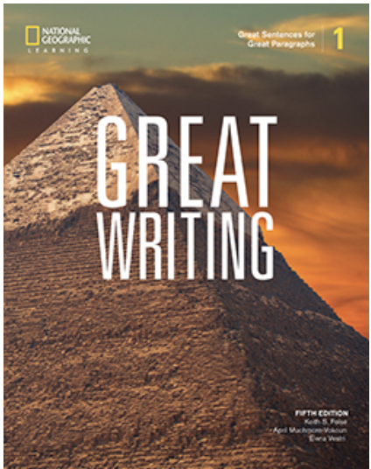


What are we accustomed to?
Level Intro:
A1-A2
Sentences
Level 1:
A2-B1
Sentences to Single Paragraph
Level 2:
B1
Single Paragraphs
(again?)
Level 3:
B2
Essays (4+ paras.)
Notes:
Goes against 99% of what you see out there
Easy to teach and learn
Formulaic
Constraints of publishers
Their own interpretation of CEFR
Such a jump

Slide 15
A help or a hinder?
”The problem with the five-paragraph formula its offer of structure stops the very thinking we need students to do. Their focus becomes fitting sentences into the correct slots rather than figuring out what they’re trying to say and the best structure to say it.”
K. Campbell, Beyond the Five-Paragraph Essay
Notes:
5-paragraph essay only since 1960s
Why can’t be taught concept of main idea sentence + supporting sentence right away?

Slide 16
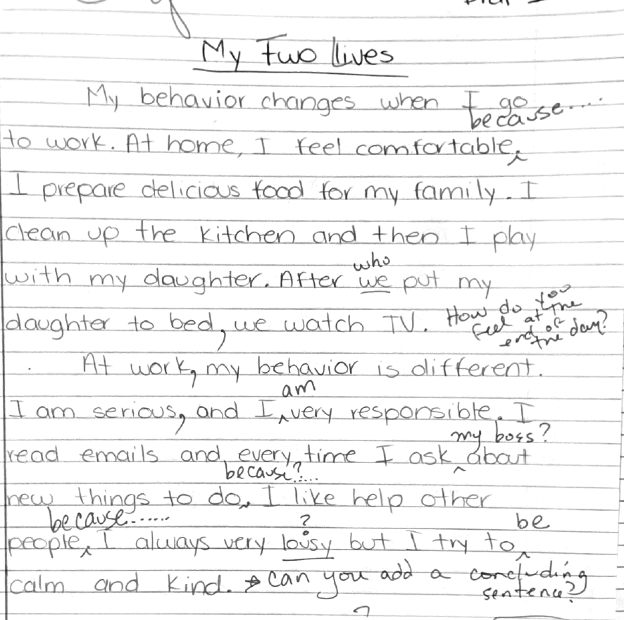
Can beginner students handle multiple paragraphs?

Slide 17
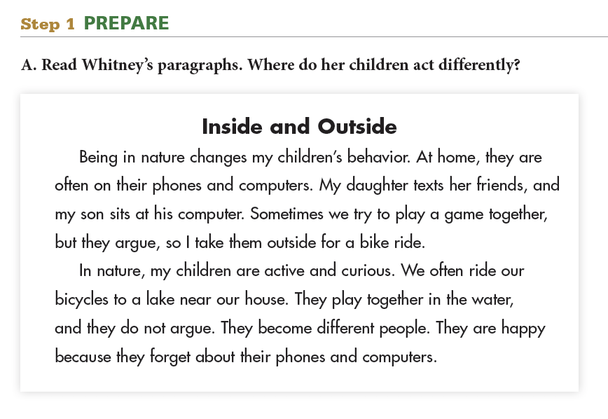
Notes:
My experience
Published this book in 2015.
Self-promotion
7 years later!
Breakthroughs

Slide 18
Why teach multiple paragraphs at the beginner level?
Paragraphing should be a smaller jump.

Slide 19
Why teach multiple paragraphs at the beginner level?
Paragraphing should be a smaller jump.
More of the students’ ideas are relevant.

Slide 20
Why teach multiple paragraphs at the beginner level?
Paragraphing should be a smaller jump.
More of the students’ ideas are relevant.
The concluding sentence has a more meaningful purpose.

Slide 21
Why teach multiple paragraphs at the beginner level?
Paragraphing should be a smaller jump.
More of the students’ ideas are relevant.
The concluding sentence has a more meaningful purpose.
We can teach grammar at the point of need.

Slide 22
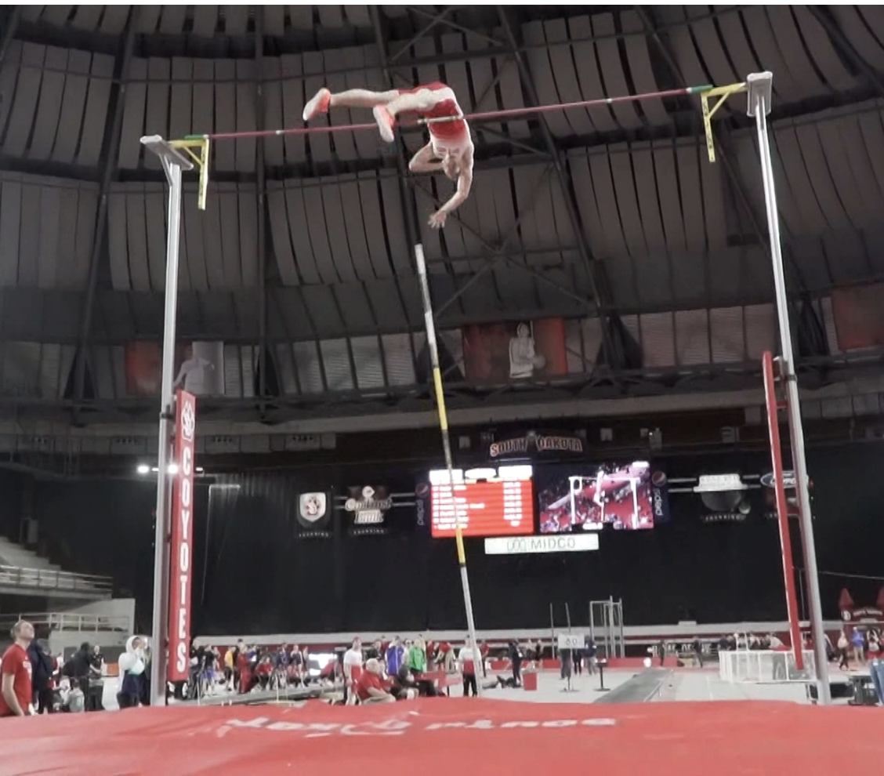
1. Paragraphing should be a smaller jump.
Notes:
Shouldn’t be a leap

Slide 23
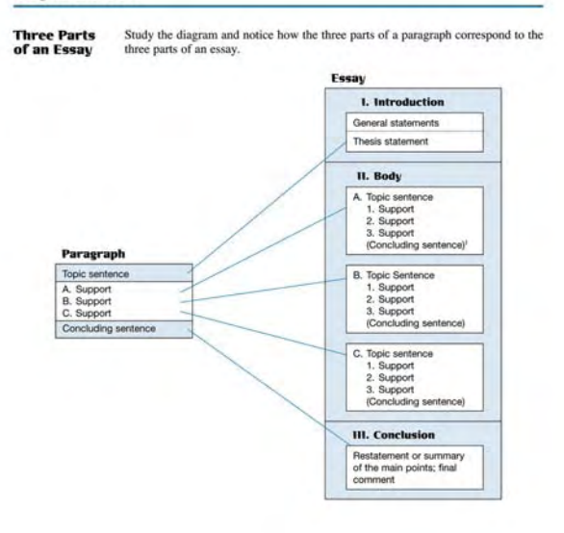
Most Textbooks
Notes:
A giant leap
Bloated paragraph

Slide 24
Two-Paragraph Assignments
Notes:
An assist

Slide 25
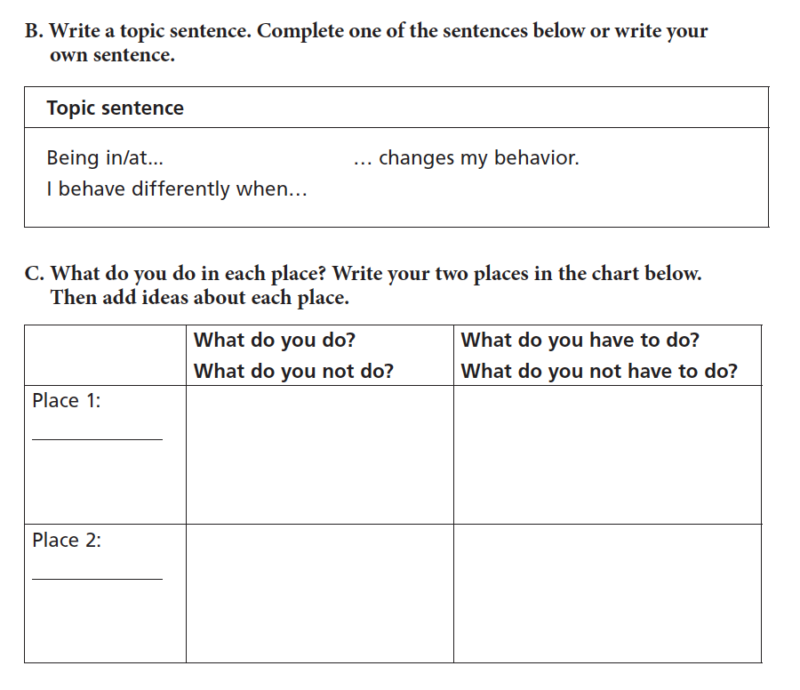
Two-Paragraph Assignments
Notes:
Place 1, place 2
Time 1, time 2 – past, since then
2 people – compare
2 cities
Where you grew up, what you did
What did your city build? What is life like now?

Slide 26
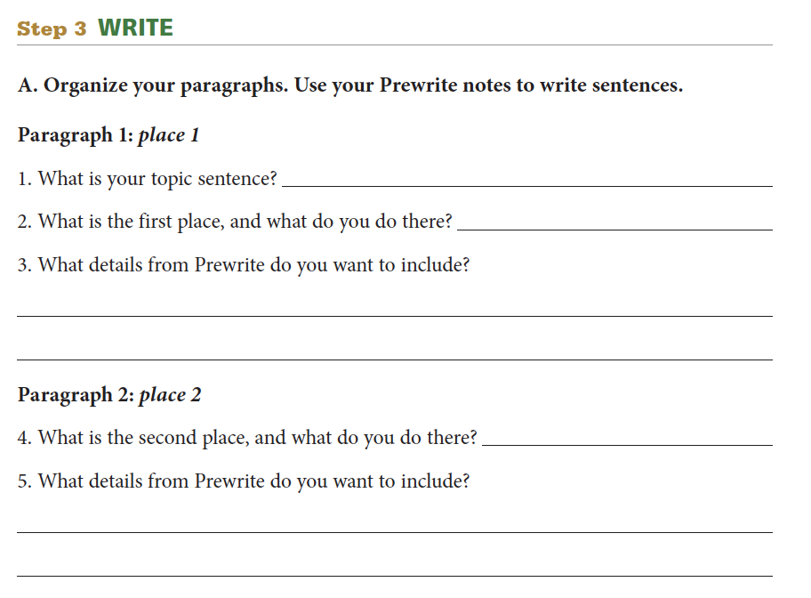
Two-Paragraph Assignments
Notes:
Scaffolding

Slide 27
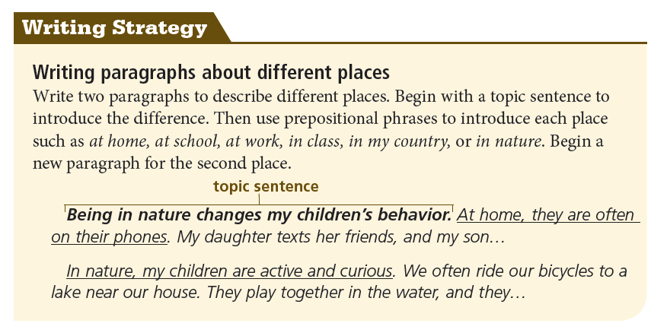
Two-Paragraph Assignments
Notes:
Main idea, support, main idea, support
2 different places, two different people.
Where you grew up, what you did there.

Slide 28

2. More of the students’ ideas are relevant
Notes:
Punish students
Unity can be restricting

Slide 29

Forced “unity” can be constricting.
Notes:
You don’t have to take out your idea.
Just start a new paragraph.

Slide 30
Can you spot the irrelevant sentence?
My neighbor Oliver has good social skills. When he invites us to his house, he greets me with a smile. We sit outside together, and he offers me hot tea and small sandwiches. Oliver travels for work, so he often talks about his adventures in other countries. Oliver is from England, but he lives in the United States. It is fun when he tells stories. We laugh a lot, and we enjoy our time together.

Slide 31
Can you spot the irrelevant sentence?
My neighbor Oliver has good social skills. When he invites us to his house, he greets me with a smile. We sit outside together, and he offers me hot tea and small sandwiches. Oliver travels for work, so he often talks about his adventures in other countries. Oliver is from England, but he lives in the United States. It is fun when he tells stories. We laugh a lot, and we enjoy our time together.

Slide 32
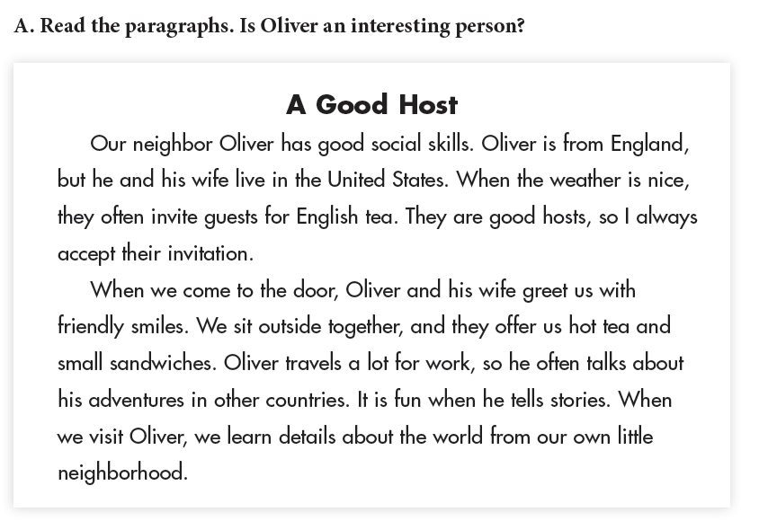
It doesn’t have to be irrelevant….
I. Background about Oliver
2. Visiting Oliver

Slide 33
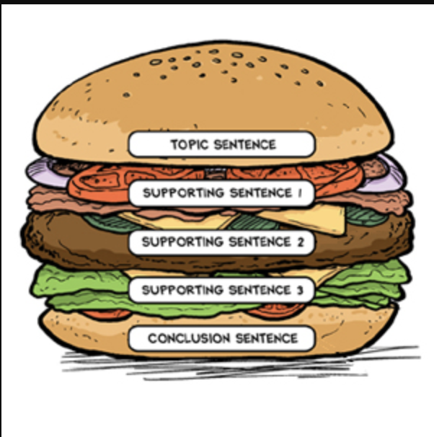
3. Concluding Sentences make more sense.
Notes:
Conclusions that introduce a new idea
My students added a new paragraph

Slide 34
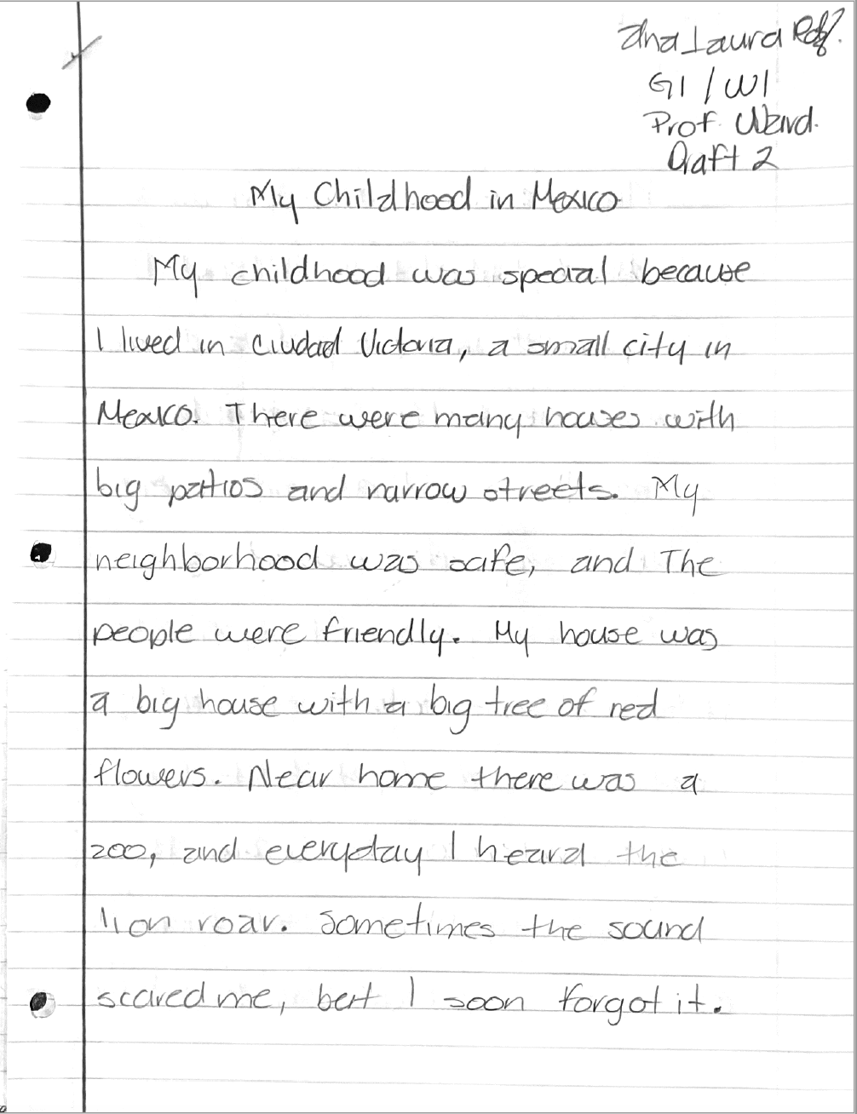
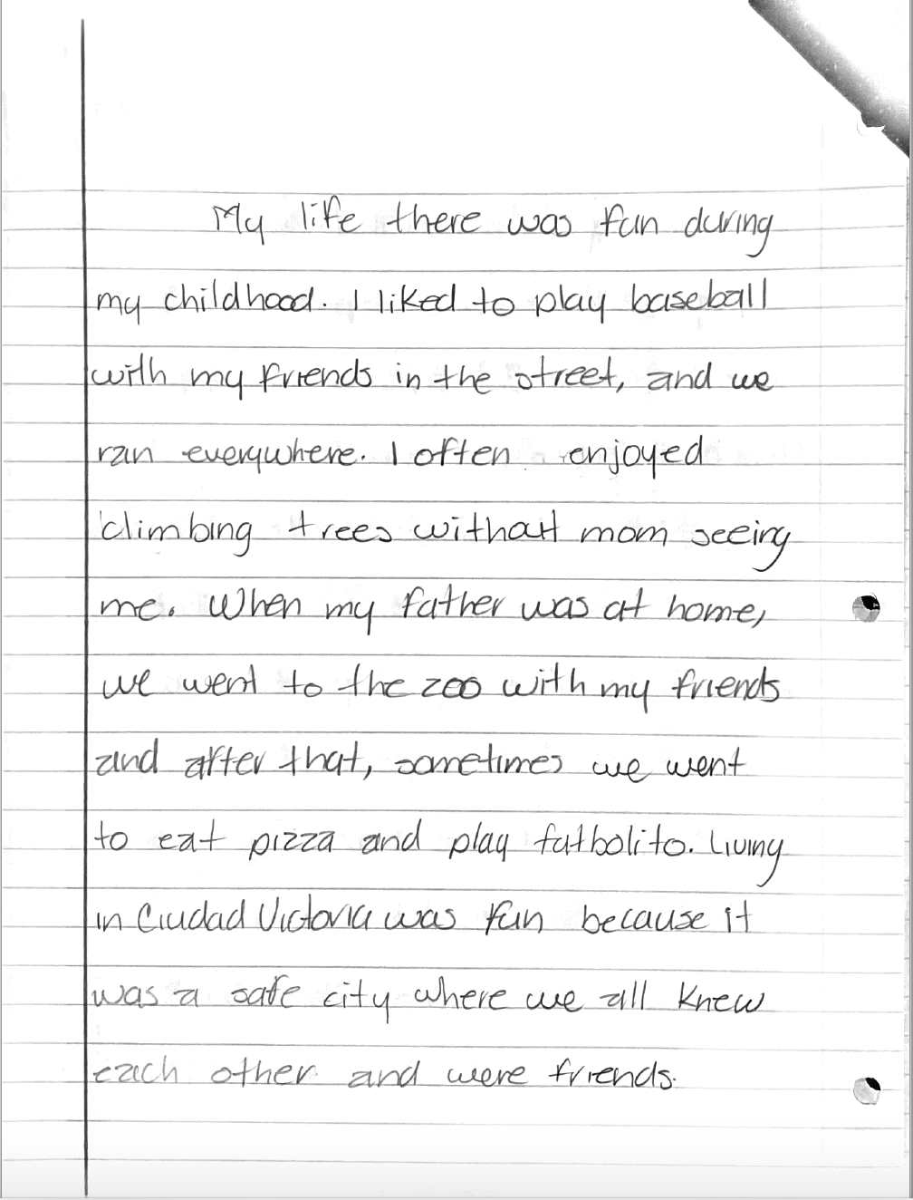
Concluding Sentence: Living in Ciudad Victoria was fun because it was a safe city where we all knew each other and were friends.

Slide 35
Concluding Sentence: Living in Ciudad Victoria was fun because it was a safe city where we all knew each other and were friends.

Slide 36
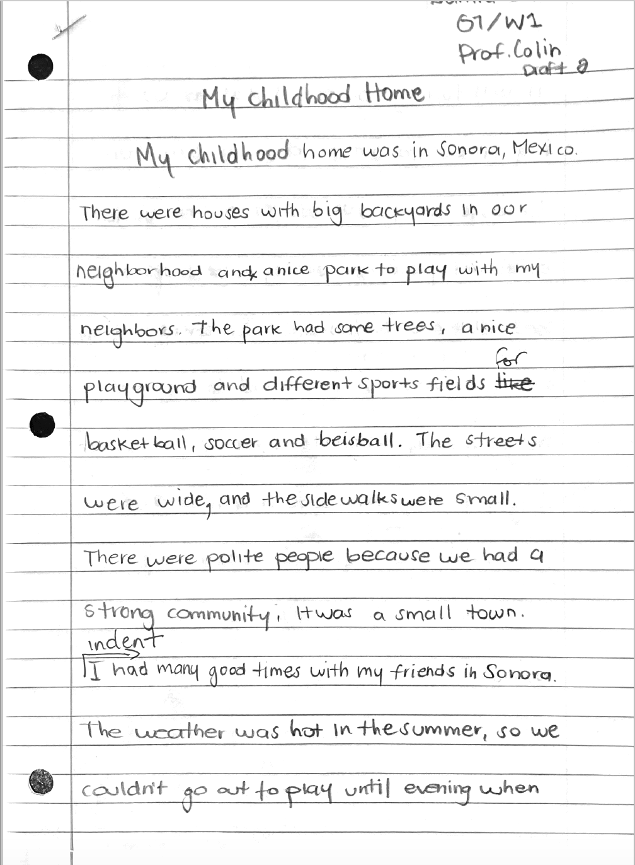
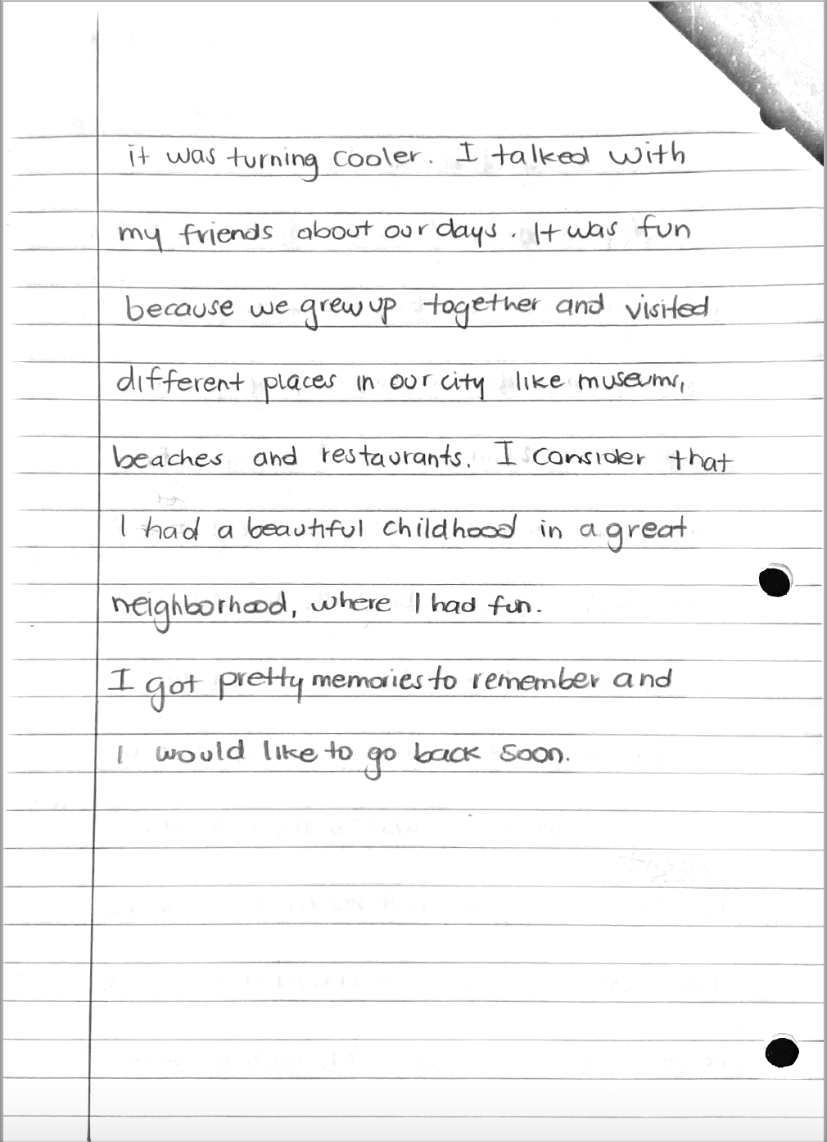
An opportunity for a concluding paragraph?
Notes:
Conclusions that introduce a new idea
My students added a new paragraph

Slide 37
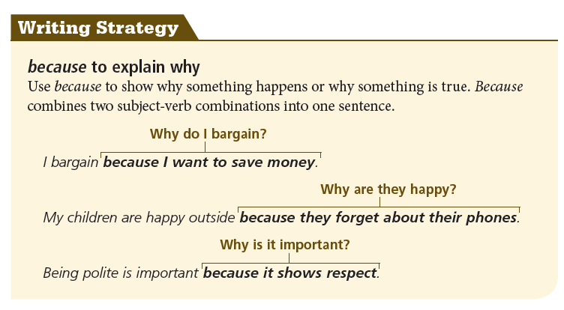
4. We can teach grammar at the point of need.
Notes:
A revision Strategy!!

Slide 38
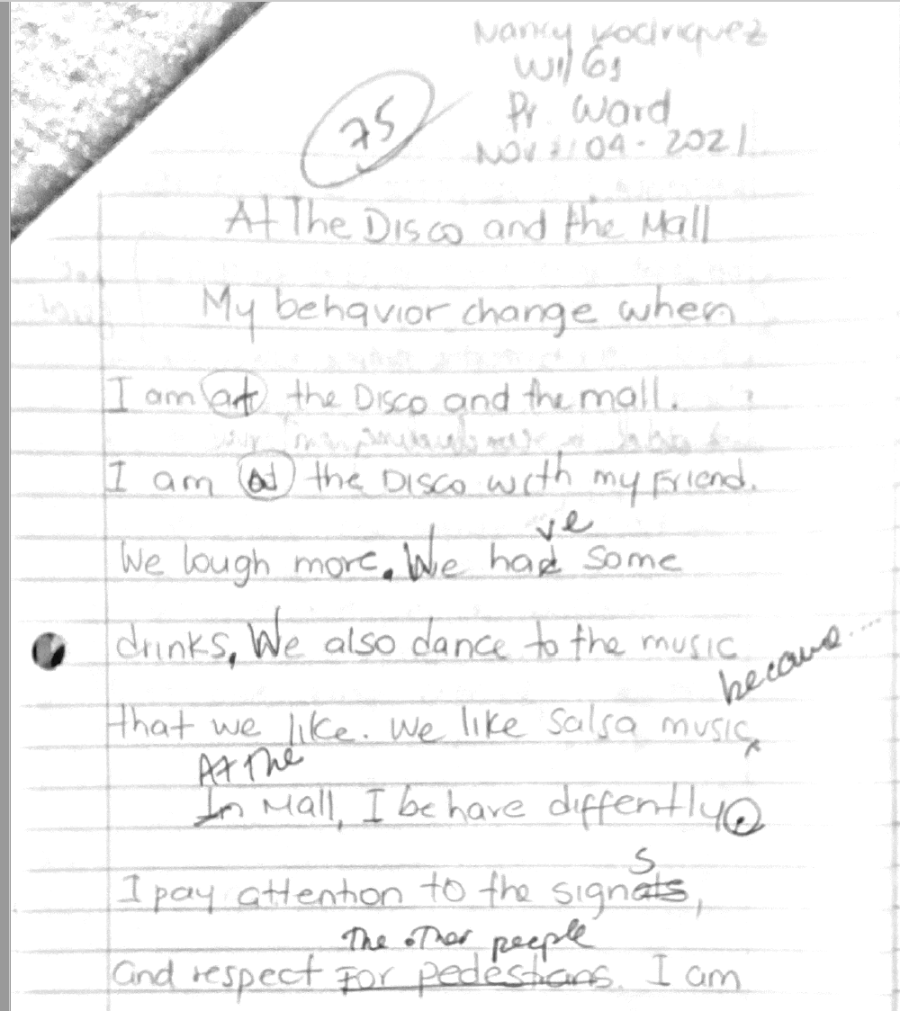

Slide 39
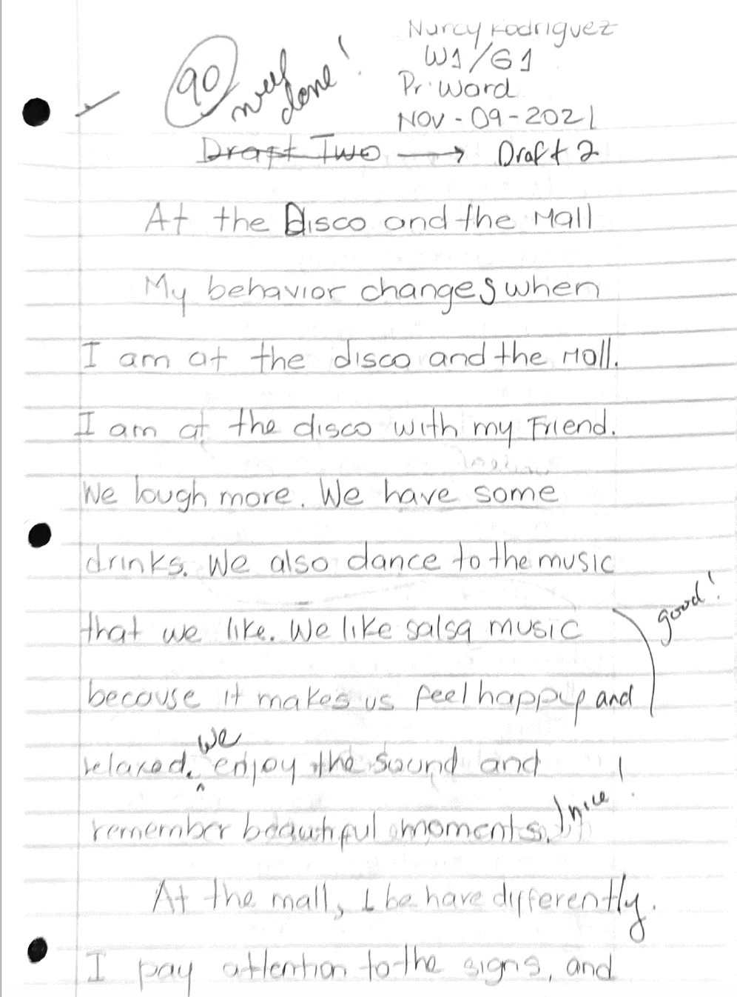
We like salsa music because it makes us feel happy [and] relaxed.

Slide 40
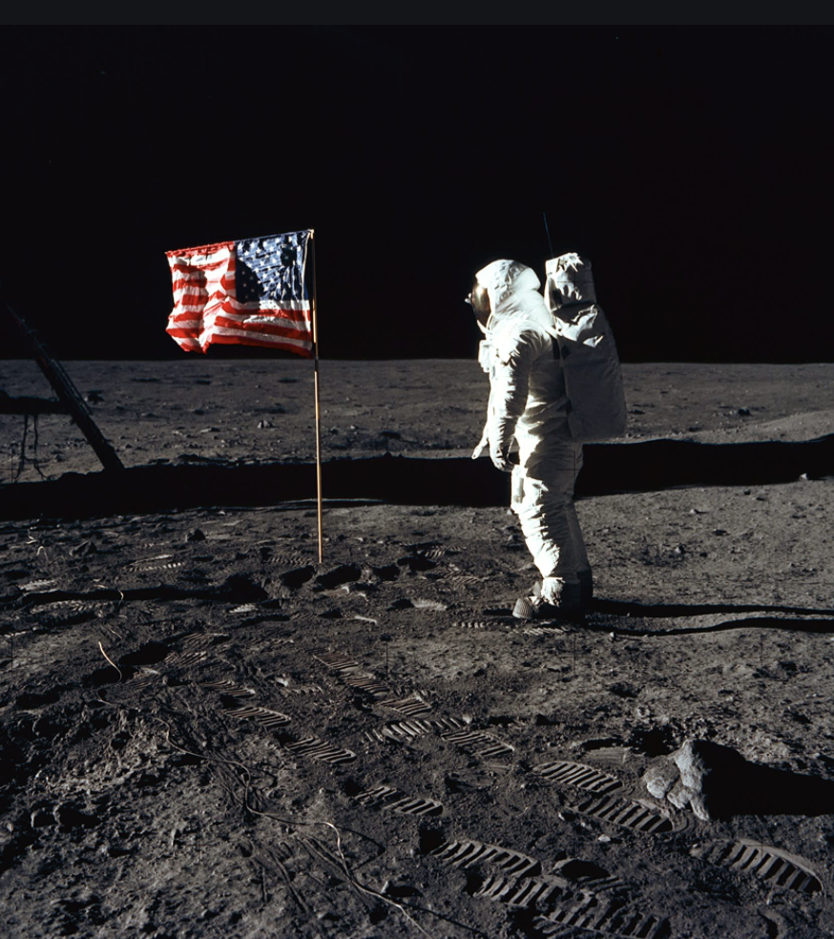
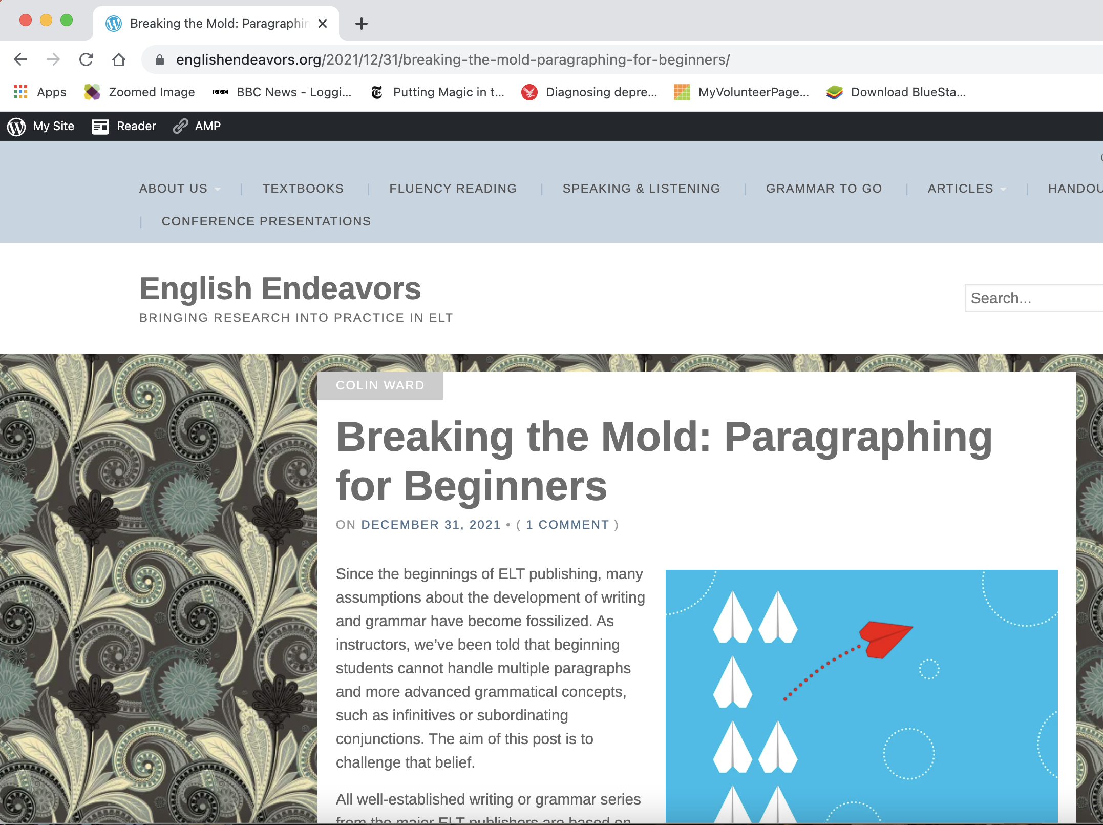
Final Comments
Notes:
Students don’t have to be Neil Armsgrongs
Fossilized

